Slide 1

Bogor Traffic Prediction Model
Data Science Mini Project
DSLS 2023
Author : Ihsan Nur Faqih

Slide 2
Contents
Business Understanding
Data Understanding
Data Cleaning & Preprocessing
Modeling
Evaluation

Slide 3
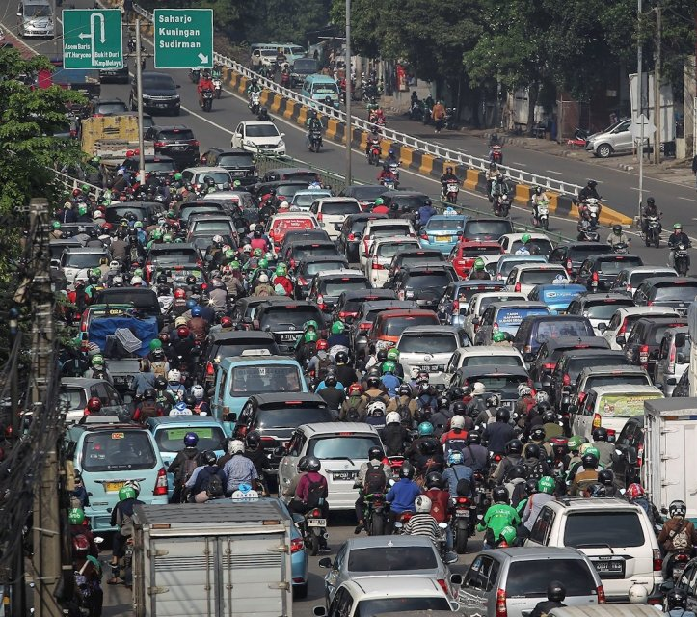
Business Understanding
Traffic jam is one of the biggest problem in Indonesia, particularly in Jabodetabek
According to Worldbank, Indonesia lost 56 Trillion IDR/year due to traffic jams
Preventing traffic jam might be solution to reduce loss

Slide 4
Solution Proposed
Using historical data of street condition, weather condition, and public holiday data to predict traffic condition on a street.
Using model generated we can predict traffic jam on a street before it is happened

Slide 5
Contents
Business Understanding
Data Understanding
Data Cleaning & Preprocessing
Modeling
Evaluation

Slide 6
Data Understanding
To deliver solution, data gathered from several sources:
Traffic data gathered from Waze
Weather data gathered from OpenWeather
Public holiday gathered from Indonesia Public Holidays 2022 - PublicHolidays.co.id

Slide 7
Contents
Business Understanding
Data Understanding
Data Cleaning & Preprocessing
Modeling
Evaluation

Slide 8
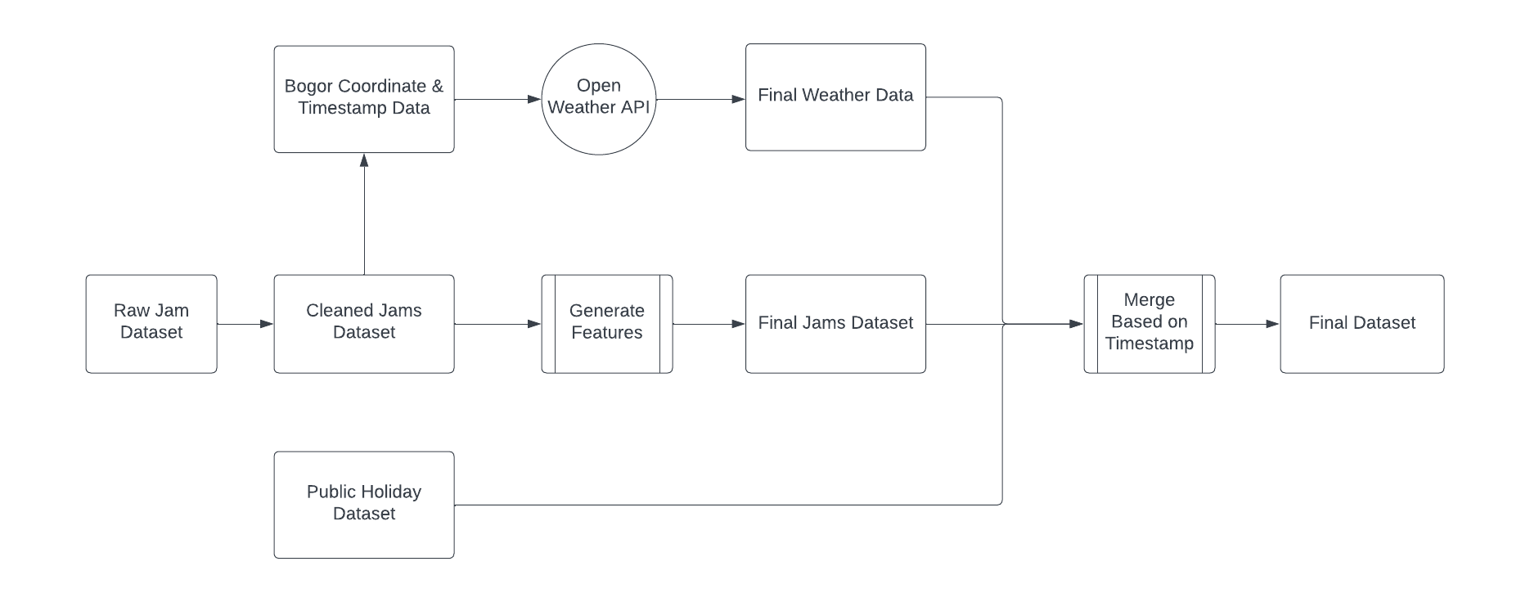
Data Cleaning & Preprocessing
Final Dataset Preprocessing

Slide 9
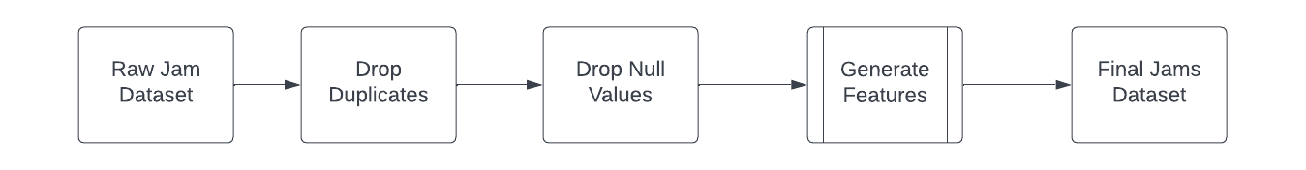
Data Cleaning & Preprocessing
Jam Dataset Preprocessing

Slide 10
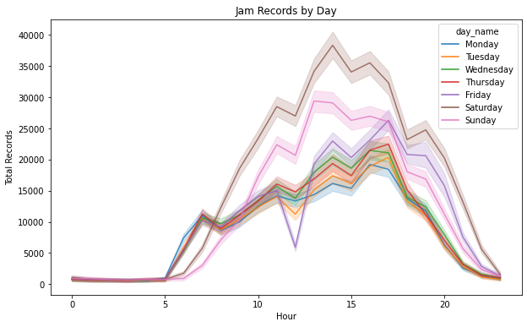
EDA
Findings
Traffic jam mainly happened in Friday, Saturday, and Sunday (weekend)
Traffic jam reach peak during 13.00 and gradually decline at 17:00

Slide 11
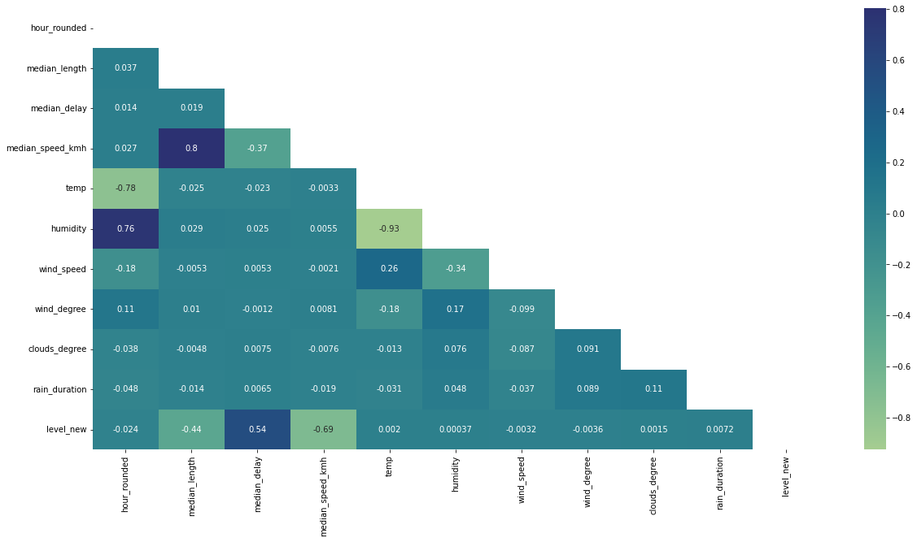
EDA
Correlation between Feature
Notes:
There will be no feature will drop, all the feature will be used in modeling

Slide 12
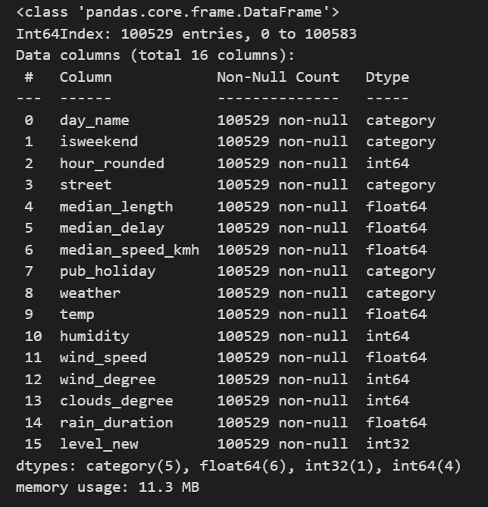
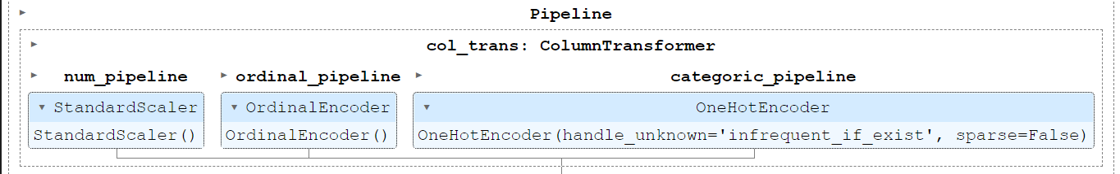
Final Data & Pipeline
Numeric columns (hour_rounded, median_length, etc.) will be treated with num_pipeline, which standard scaler
Ordinal columns (day_name) will be treated with ordinal_pipeline
Categoric columns (isweekend, street, pub_holiday, and weather) will be treated with categoric_pipeline

Slide 13
Contents
Business Understanding
Data Understanding
Data Cleaning & Preprocessing
Modeling
Evaluation

Slide 14
Modeling
The model will be predict traffic in Bogor City with category as below:
1 (80% free flow to 41%)
2 (40% free flow to 21%)
3 (20% free flow to blocked road)
During training 4 model trained to predict the category:
Logistic Regression (Multiclass Classification)
RandomForest Classifier
Decision Tree Classifier
Support Vector Classifier

Slide 15
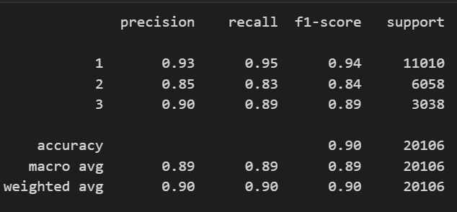
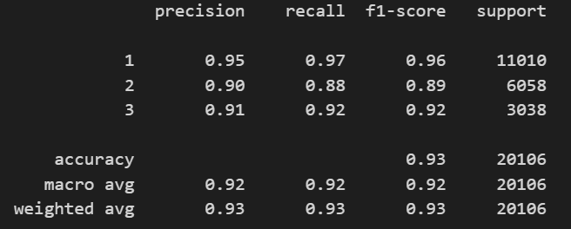
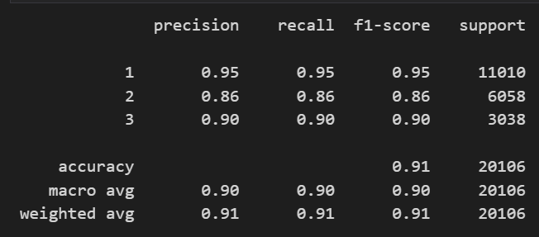
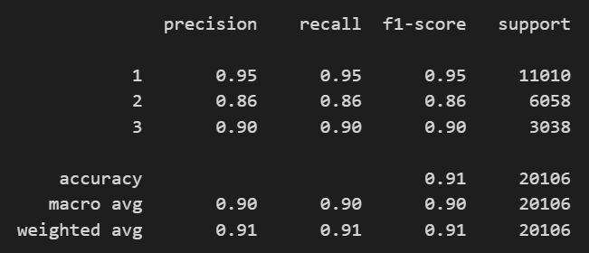
Modeling Result: Logistic Regression will be chosen
Logistic Regression
Random Forest Classifier
Decision Tree Classifier
Support Vector Classifier

Slide 16
Modeling Conclussion
All the model can predict traffic in Bogor City accurately:
Logistic Regression (Multiclass Classification) (0.90 F1 Score)
RandomForest Classifier (0.93 F1 Score)
Decision Tree Classifier (0.91 F1 Score)
Support Vector Classifier (0.91 F1 Score)
Logistic Regression will be chosen due to it interpretability

Slide 17
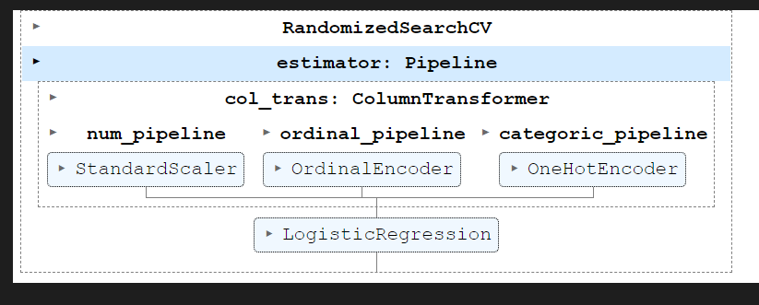
Hyper Parameter Tuning
Hypterparameter tuning will be conducted with condition as below using RandomizedSearchCV:
Penalty = [‘none’, ‘l2’]
Solver = [‘saga’, ’newton-cg’, ’lbfgs’]
Cv = 5
Scoring = ‘f1_weighted’
With pipeline as below :

Slide 18
Contents
Business Understanding
Data Understanding
Data Cleaning & Preprocessing
Modeling
Evaluation

Slide 19
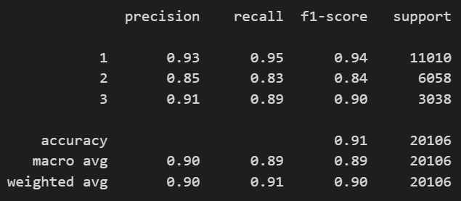
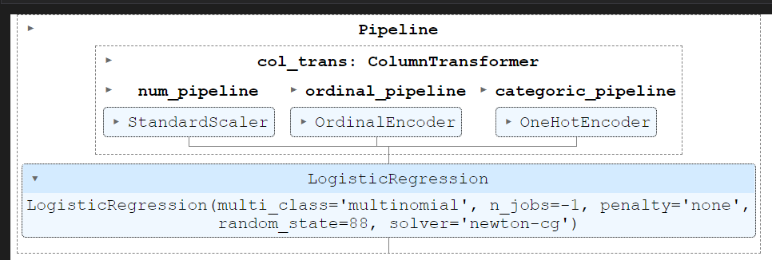
Evaluation
After hyper parameter tuning has been done, the result showed that the model get higher f1_score than before (increase 0.01)
Best Parameter Pipeline

